Slide 1
Resampling Methods
© 2025 Virginia Polytechnic Institute and State University. All rights reserved.

Slide 2
At the end of this module, you should be able to:
Define resampling
Identify types of cross-validation
Describe the bootstrap process
Describe pros and cons of resampling methods
Implement basic cross-validation and bootstrap methods using Python

Slide 3
Resampling Methods

Slide 4
Introduction to Machine Learning Course Roadmap
What is the goal of the data analysis?
Predict an output |  |  |  |  |  | Reveal patterns or relationships |  | Make decisions using an autonomous agent
Supervised Learning (Output in the data set) |  |  |  |  |  | Unsupervised Learning (No output in the data set) |  | Reinforcement Learning* (Supervised & unsupervised)
Continuous or discrete output? |  |  |  |  |  | What is the subgoal? |  | Does a model exist?
Continuous |  |  | Discrete |  |  | Identify groups | Reduce dimensions | Model Based | Model Free
Simple linear regression Multiple linear regression Subset selection Ridge regression & LASSO PCR & PLS | Polynomial regression Step functions Splines Local regression General additive models | Decision tree Random forest Neural network Gradient boosting tree | Logistic regression Linear discriminant analysis Quadratic discriminant analysis | Decision tree Random forest Neural network Gradient boosting tree | Support vector machines | Hierarchical clustering K-means clustering | Principal components analysis | Given the model Learn the model | Policy Optimization Q-Learning
*Advanced Topic: Bonus module if time

Slide 5
Supervised versus unsupervised again
Some tangible measurement(s)
“The Black Box”
INPUTS
MACHINE LEARNING MODEL
OUTPUT(S)
Supervised Learning
In the context of domain knowledge
“The Black Box”
INPUTS
MACHINE LEARNING MODEL
PATTERNS,
RELATIONSHIPS, STRUCTURE
Unsupervised Learning
does it make sense?
Notes:
In the machine learning modules, we always want to ground you in the application of the techniques presented. Resampling methods can be used in both supervised and unsupervised learning.
Cross-validation methods, the first we will cover, are typically used in supervised learning context where we have an output to model.
Bootstraps methods, the second we will cover, may be used in either

Slide 6
Supervised learning method selection is based on the response type
Is my response quantitative or qualitative?
Age
Height
Income
Stock Price
Tensile Strength
Quantitative
Qualitative
Blood Type
Default on Debt (y/n)
Cancer Stage
Brand Purchased
Species
Typically use regression method
Typically use classification method
Discrete: Nominal or Ordinal
Continuous Measures
What about the predictors?
For most methods, predictors can be
either quantitative or qualitative.
Notes:
Resampling methods are very versatile in that they can be used with regression and classification methods.

Slide 7
Two methods of estimation
Parametric
(Less Flexible, More Interpretable)
Non-parametric
(More Flexible, Less Interpretable)
Inference focused
Select a model which involves an assumption about the functional form of f. Train the model and estimate parameters.
Example:
f is linear in X: f(X) = β₀+β₁X₁ + β₂X₂ +…+ β_{p}X_{p}
Prediction focused
Does not make explicit assumptions about the functional form of f. Can fit wider range of possible shapes for f, but at that cost of needing a larger number of observations.
Example:
Splines
Notes:
Resampling methods can also be used in both parametric and non-parametric methods. In the non-parametric context, they are commonly used to tune parameters, for example, spline smoothing parameters. In the parametric context, they are also used for tuning parameters, like the smoothing parameters we saw in ridge regression and LASSO, but also used to select the “best” values for slope parameters or give insight to the “best” combination of variables to use in a multiple regression problem.
Resampling can be used to tune model parameters, evaluate model performance , and select the best model if comparing multiple models

Slide 8
Resampling Methods

Slide 9
Resampling can be used to tune parameters and evaluate model performance
Resampling is the act of drawing different samples from available data.
How is this useful? We can see how the model we’re using and its results change as we change the data we used to build it.
Two most common methods for resampling: (1) Cross-Validation (2) Bootstrapping
Population
Sample
Resample
Notes:
Resampling is the act of drawing different samples from the available data we already have. Why is the useful? Resampling allows us to see how the model we’re using, and it’s results, change as we change the data used to build it. The two most common methods that use resampling are cross-validation and bootstrapping. Within the context of the training and test set paradigm, resampling will help us understand how the model performance changes based off of how we split our data into training and test sets.
Resampling can be used to tune model parameters, evaluate model performance , and select the best model if comparing multiple models

Slide 10
Resampling Methods

Slide 11
ML paradigm
TRAIN
VALIDATE
TEST
Use the training subset to fit the initial model
Use the validation subset to evaluate & tune the model
Use the testing subset to get an unbiased evaluation of the final model
Notes:
Recall our training and test set paradigm used across machine learning algorithms. The data you have available is randomly split into a training, validation, and test set. The training set is used to fit an initial model. That model is then tuned using a validation set. Then the test set is used to get a final unbiased evaluation of its performance.
Emphasize - This course will focus mainly on Train and Test

Slide 12
A common way to evaluate model performance is through test error
Test Error: average error that results from using a machine learning method to predict the response on data that was not used in training the method
Models are built to do well on the data they’ve been fed. We want to ensure they also do well on data they haven’t encountered.
Whole Sample
Randomly
divide
Training set
Fit
Model
Prediction
Validation set
Tune
Test
Test Error
Test set
Notes:
A common way to evaluate its performance in this paradigm is through test error. The model is used to make predictions on the test set, which the model has not yet “seen”, and from these predictions we can get test error. Test error is the average error that results from using a machine learning method to predict the response on data that was not used in training the method. Remember, the model was only built using the training and validation sets, thus it was built to do well on that data. We want to ensure the model will also do well on new data, which is why a test set is used.
Recall for the purposes of this course, we will limit ourselves to training and test (exclude validation)

Slide 13
Drawbacks of training and test set paradigm
Only trained on these
Model is trained on fewer samples
Model may be highly dependent on how the samples were split into training, validation, and test sets
Tends to overestimate the test error
We will examine two cross-validation approaches that overcome this drawback:
Leave-One-Out Cross-Validation (LOOCV)
k-Fold Cross-Validation
Whole Sample
Training set
Randomly
divide
Fit
Model
Prediction
Validation set
Tune
Test
Test Error
Test set
Notes:
There are some drawbacks to simply holding out some of the data as a test set. First, the model is trained on fewer samples. As we’ve discussed, the model is only trained on part of the data. Wouldn’t it be nice to be able to use all the data to build the model to gain the most information? Another drawback is that the model may be highly dependent on how these samples were split into training, validation. and test sets. What if a lot of the extreme observations were in the test set and the model wasn’t equipped to handle them? We may get a really high value for test error even though these values are not all that common in the true population we want to make decisions about. In general, the test error obtained using this method will tend to overestimate the prediction error when fitting the model to all of the data. We will examine two cross-validation approaches that can overcome these drawbacks: Leave-one-out cross-validation, or LOOCV, and k-fold cross -validation.
Recall for the purposes of this course, we will limit ourselves to training and test (exclude validation)

Slide 14
Resampling Methods

Slide 15
LOOCV steps
1 observation
n-1 observations
We split the dataset into 2 parts: one part containing just 1 observation (Test Set), the second containing all the others (Training Set)
We fit the model using the training data, and use it to predict the one left out observation
Test
Train
Test
Train
Model
Prediction
Notes:
We will begin with leave one out cross validation. In this method, we first split into our training and test set, but in this case, the test set will only contain the first observation. We then train the model using the rest of the observations and then use that model to predict the outcome of the one observation held out for the test set.

Slide 16
LOOCV steps
We see how far off our prediction was from the true value and record that
Test
Prediction
Test Error 1
Notes:
We use some metric to determine how far our prediction was from the truth, and record that as error 1. The metric used here depends on the application. Metrics for specific machine learning applications will be discussed as we introduce them in other modules.

Slide 17
LOOCV steps
We repeat the process for all observations in the dataset, each time leaving out a different one and recording how far off we were
We average our measures of how far off we are from the truth
Test Error 2
Test Error 3
. . .
Test Error n
. . .
Average Test Error
Test Error 1
Test Error 2
Test Error n
Notes:
We then repeat this process for each observation in the dataset, so that each observation is held out as a test set exactly once. Each time we record the resulting error. We then average those measurements of error to get a more accurate measure of prediction error for when we fit a model using the whole data set.

Slide 18
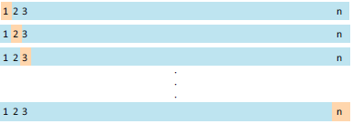
LOOCV pros & cons
Pros
We’re now using ALL available data to train the model
Model results will not change depending on what split we used for training and test data since we end up using everything, eventually
Cons
Can be computationally intensive since we often have to fit the model once for each data observation
Notes:
Let’s examine the pros and cons of the leave-one-out cross-validation method. First, a pro is that the method uses all available data to train the model at some point in the process. With leave one out cross validation, model results will not change depending on how the data is split into training and test sets since each possible split is used once. This method is good for small data sets, however, it can be very computationally expensive for larger data sets, since we have to fit the model once for each observation.

Slide 19
Resampling Methods

Slide 20
k-fold cross-validation steps
Test
We randomly divide the dataset into k equal sized groups (folds)
We fit the model using the k-1 of those groups
Common values are k=3, k=5, and k=10, and by far the most popular value used in applied machine learning to evaluate models is k=10.
Sample
Train
Model
Prediction
Notes:
K-fold cross validation is a similar procedure. In k-fold cross validation, we randomly divide the data set into k equal, or approximately equal, size groups, also called folds. Common values for k are 3, 5, or 10. We then fit the model using all but one of those folds, which we reserve as a test set.
A lower k means a smaller training set and larger test set. We would expect higher prediction error here
A higher k means a larger training set and smaller test set. We would expect lower prediction error here
As K increases, you approach leave-one-out cross-validation. Thus a larger K means less bias but higher variance
JMP model screening platform default is k=5
Python scikit-learn default is k=5
R kfold function default is k=10

Slide 21
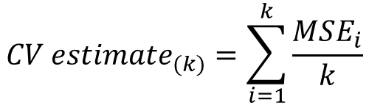
k-fold cross-validation steps
We compute our measure of error on the held out fold
Test
Prediction
Test Error 1
For regression models, we often use Test MSE as our error estimator. For classification, we would replace this with Test accuracy.
Notes:
We then compute our measure of error on that held out fold.
Note that it is common to use MSE as the measure of error for regression methods but accuracy is used for classification problems.

Slide 22
k-fold cross-validation steps
We repeat the procedure k times
We compute an average of our error measure over all k-runs
. . .
Test Error 2
Test Error 3
. . .
Average Test Error
Test Error 1
Test Error 2
Test Error k
Notes:
This process is repeated k times, with each fold held out as the test set exactly once. We then average over the k measures of error we have obtained to get an estimate of prediction error when fitting a model using the whole data.

Slide 23

When should we use k-fold CV vs LOOCV?
It depends…
LOOCV can be computationally demanding and time consuming
Not good for large data sets!
Bias-variance tradeoff for LOOCV vs k-fold CV
LOOCV has higher variance than k-fold CV
k-fold CV has greater bias than LOOCV
k = 5 or 10 in k-fold cross validation usually provides a good compromise between bias and variance.
BIAS
VARIANCE
Notes:
So when should we use k-fold cross validation vs leave one out cross validation? Well, it depends on the situation, neither method is better across the board. As you can imagine, leave one out cross validation can be computationally demanding and time consuming the more observations you have. Let’s say you have 1,000 observations. In leave one out cross validation, you would need to fit 1,00 models! Clearly, this is not an ideal method when you have a large data set including hundreds of thousands or millions of records. Another concept that should be considered is the bias-variance tradeoff we have discussed in previous modules. Leave one out cross validation had higher variance than k-fold, but k-fold has higher bias. Thankfully, this tradeoff has been explored for many applications, and it seems that k = 5 or 10 usually provide a good compromise between bias and variance.

Slide 24
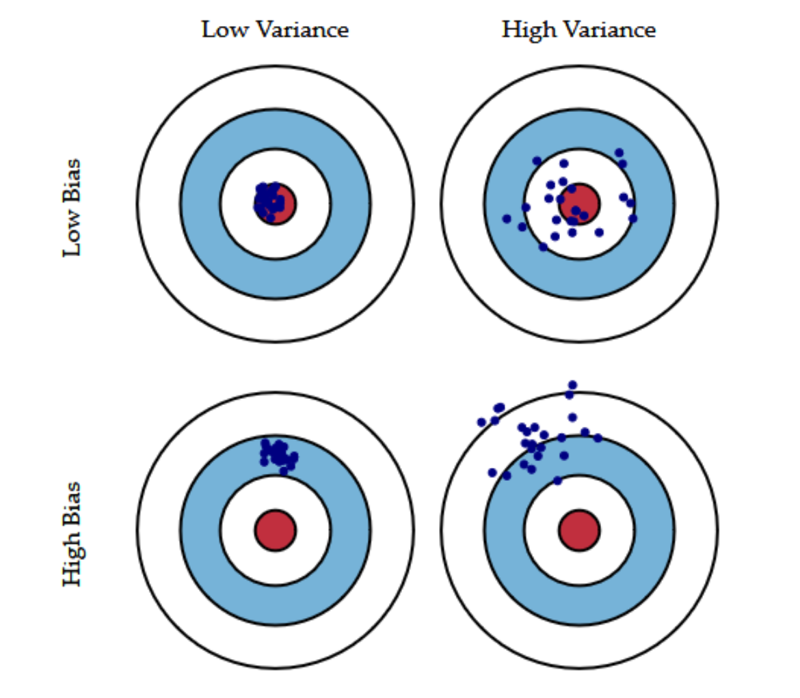
Recall the bias-variance tradeoff
Bias is the difference between the predicted value and the expected value(distance of the blue points to the center)
Variance is the variability of model prediction for a given data point(a measure of scatter of the blue points)
High-variance methods are at risk of overfitting. In contrast, high bias methods typically produce simpler models that may fail to capture important regularities in the data
Notes:
Recall the bias-variance tradeoff we discussed in the previous module
High-variance learning methods may be able to represent their training set well but are at risk of overfitting to noisy or unrepresentative training data. In contrast, methods with high bias typically produce simpler models that may fail to capture important regularities in the data

Slide 25

Why does LOOCV have higher variance?
When we perform LOOCV, we are averaging the outputs of n fitted models, trained on almost identical datasets; so these outputs are highly correlated
k-fold CV averages the outputs of k fitted models, trained on datasets that are not as similar (as long as k < n), and therefore the outputs are less correlated
The average of many highly correlated quantities has higher variance than the average of many quantities that are not as highly correlated
This increases as…
… that increases
Notes:
Presenter notes: For those who might be curious about why LOOCV has higher variance. NOTE: it is probably not necessary to spend too much time on this slide or to focus on the formula shown.
Comment that this slide is not super important for this presentation and you won’t spend time on it now but it’s there as reference for those who may want to know why LOOCV has higher variance

Slide 26
Comparison of cross-validation methods
 | Pros | Cons
Leave-One-Out Cross-Validation (LOOCV) | Uses ALL available data to train the model Model results will not change depending on how the data was split into training and test sets Good for small data sets | Can be computationally intensive since we have to fit the model once for each data observation Higher variance
k-Fold Cross-Validation | Uses ALL available data to train the model Computationally less intensive Better for large data sets | Greater bias Model results will change depending on how data is split into the k-folds
Notes:
Let’s examine the pros and cons of these two cross-validation methods side by side. First, a pro for both methods is that they both use all available data to train the model at some point in the process. With leave-one-out cross-validation, model results will not change depending on how the data is split into training and test sets since each possible split is used once. This method is good for small data sets, however, it can be very computationally expensive for larger data sets, since we have to fit the model once for each observation. It also has higher variance. K-fold cross-validation has the advantage for larger data sets, as it is less computationally expensive. A downside is that it had higher bias. We also need to keep in mind that model results will change depending on how the data is split into the k-folds.

Slide 27
Resampling Methods

Slide 28
Sampling review
5
Sample without replacement
Cannot choose the same observation more than once
2
5
4
3
2
1
4
3
1
Population
Sample with replacement
Can choose the same observation more than once
2
2
4
3
1
1
4
3
1
Notes:
Presenter notes:
***This slide has animations – may want to review ahead of time and possibly tweak the timing of animations depending on how you present the material***
Before we get into our second resampling method, we need to briefly review sampling with and without replacement.
Say we want to sample 5 observations from a population. To sample without replacement means we randomly draw observations from the population one at a time until we have our 5 observations. Since we do not replace each observation after selecting it, we cannot choose the same observation more than once.
But if we were sampling with replacement, that means that after we select an observation, we replace it in the population and randomly select an observation again. With replacing the observations, it is possible to choose the same observation more than once, as we see with the blue oval in this example.
The resampling procedure we are about to introduce focuses on sampling with replacement.

Slide 29
Bootstrap
Rather than splitting the data into several independent data sets (like cross-validation), the bootstrap method resamples with replacement from the original data to construct a series of distinct, but not independent, data sets
Used to quantify uncertainty in a less complex way
Easy to apply
Works for many machine learning methods
Notes:
While cross-validation and bootstrapping are both resampling methods, they key difference between them is how they resample from the data. In cross-validation, we are essentially sampling without replacement to split the data into training and test sets, which are independent. In bootstrapping, rather than splitting the data into several independent data sets, we sample with replacement from the original data to construct a series of distinct, but not independent, data sets. As we’ve seen so far in this module, bootstrapping can be used across many aspects of machine learning. It is a flexible and powerful too that can quantify uncertainty in a less complex way than other procedures. It is also easy to apply, even to complex methods.

Slide 30
Bootstrap procedure
Step 1: Sample with replacement from original data to create a new dataset
Step 3: Compute estimators / apply ML method to each of the B new dataset
Sample 1
Sample 2
Original Data
Step 2: Repeat Step 1 B times (e.g. B = 1,000)
Sample B
Step 4: Summarize across all B results
Notes:
Presenter notes:
***This slide has animations – may want to review ahead of time!***
The bootstrap starts by sampling with replacement from your original data until you have a new dataset the same size as your original data. In this case, our original data had 10 observation (or dots/ovals) so our bootstrap sample should have 10 observations from sampling with replacement.
Then we do the same thing again, getting a second bootstrap sample from sampling with replacement from our data.
We continue this process until we have some large number of bootstrap samples. The number of bootstrap samples necessary depends on the problem at hand. Typically, 800 - 1,000 is sufficient though with simple problems it can be easy to use 10,000 or more without sacrificing much time or computation. (A text that has a few similar suggestions as well as a more complicated way to calculate it for specific problems: Bootstrap Methods: A Guide for Practitioners and Researchers, Second Edition, by Michael R. Chernick)
From here, we compute our estimators or apply our desired machine learning method to each of the bootstrap samples separately. So if we have 1,000 bootstrap samples, we will have 1,000 different results.
Then, you want to summarize all of your results, and there are many ways to do this. The way our estimators and variables of interest change across these runs provide our measure of uncertainty
From Hesterberg (2015) https://doi.org/10.1080/00031305.2015.1089789
Brad Efron, inventor of the bootstrap, suggested in 1993 that r = 200, or even as few as r = 25, suffices for estimating standard errors and that r = 1000 is enough for confidence intervals (Efron and Tibshirani Citation1993).
I argue that more resamples are appropriate. First, computers are faster now. Second, those criteria were developed using arguments that combine variation due to the original random sample with the extra variation from the Monte Carlo implementation.
10,000 is good for routine use

Slide 31
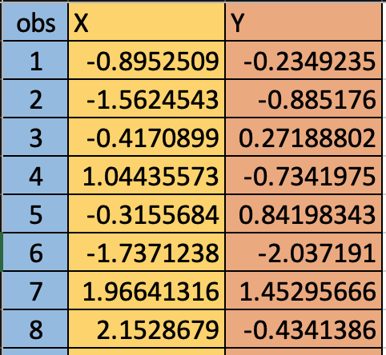
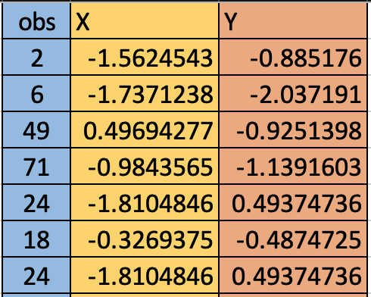
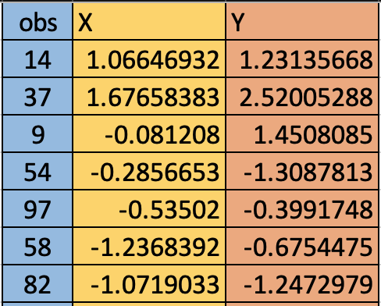
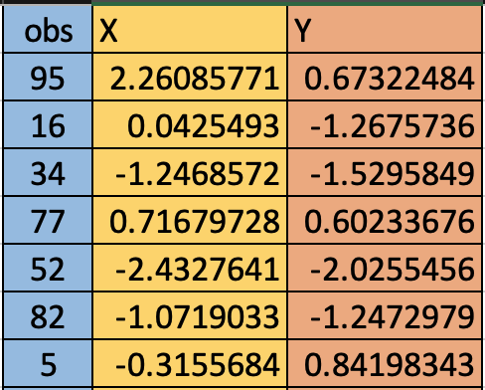
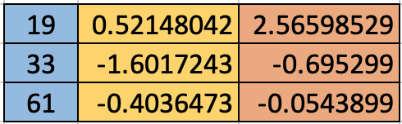
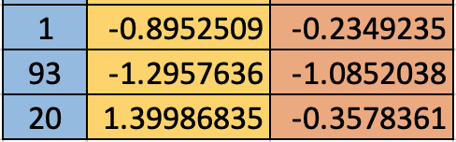
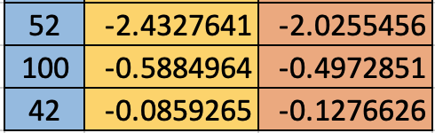
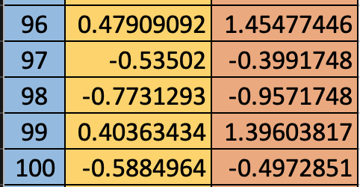
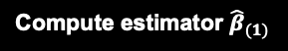
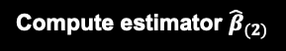
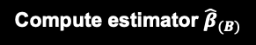
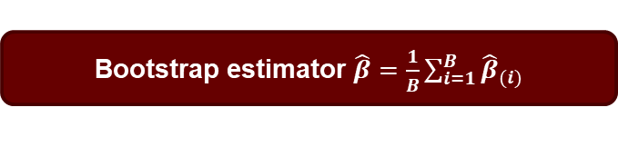
Bootstrap example
Sample with replacement from original data
…
100 observations
100 observations
100 observations
…
…
…
…
Sample 1
Sample 2
Sample B
Portfolio.csv
Original Data
Notes:
Suppose we want to estimate the coefficient beta in the simple linear regression model: 𝑌=𝛼+𝛽𝑋+𝑒 using bootstrap method
We take B samples of size 100 (with replacement) and estimates the slope in each. Our final estimate is the average of the B slopes

Slide 32
Why does the bootstrap work?
Resample
No new observations
Sample
Population
Data
Bootstrap Samples
The more data, the better!
Approximate
Notes:
Presenter notes:
***This slide has animations – may want to review ahead of time!***
So why does the bootstrap work?
Our data is simply a sample from a population and ideally we want it to be a random sample that is representative of that population. The bootstrap treats the data we have as the new “population”. As with most methods, the more data we have to begin with, the better the bootstrap procedure will work.
To get more information from this new “population”, we sample from it repeatedly. Again, this is a resampling procedure, so we cannot get any new observations that did not appear in our original data. For example, we can see there are maroon dots in the population, but we did not have any in our data, so we also will not have any in our bootstrap samples. This also shows the importance of having a representative sample.
While the bootstrap cannot provide new observations, it is useful for approximating how all possible values from the true population behave

Slide 33
Common uses of the bootstrap
Uncertainty estimation in machine learning techniques
Confidence interval approximation
Hypothesis testing alternative
Machine learning technique evaluation against variations in the data
Foundation of some tree-based methods
Notes:
So when is the bootstrap actually used?
It is commonly used to estimate uncertainty in machine learning techniques. For example, it could be used to estimate the standard error of the coefficients in a regression model. Estimating uncertainty in any statistical technique it critical and these estimates should always be presented with statistical results. We always hope our statistical models and methods provide some useful and accurate insight into data, but they will never be perfect. In other words, sometimes they will be wrong, and we want to know when and where they are more likely to be incorrect.
Bootstrapping is also commonly used to construct approximate confidence intervals around parameter estimates. Again, consider estimation in regression, we could use bootstrapping to construct a confidence interval around the parameter estimates. It can also be used as an alternative to hypotheses testing.
Bootstrapping could be used to test if the slope of one of our variables in regression is equal to zero or not.
It is also commonly used across machine learning techniques to see how those techniques change based on variations in the data. The more the results change from bootstrap sample to bootstrap sample, the more unstable those methods and results are. For example, in the unsupervised learning framework, bootstrapping can be used to evaluate the stability of clustering algorithms. In other words, how much do the clusters change as we change the composition of data points in our sample?
Another common use is within some tree-based methods such as bagging and random forests. Tree-based methods will be covered in a series of later modules.

Slide 34
Using the bootstrap to estimate test error
The bootstrap may be used as an alternative to cross-validation depending on how you use it
The bootstrap can seriously underestimate the true prediction error if your test set contains observations that were included in your bootstrap sample
Better way: use the observations not included in the bootstrap sample as your test set
Notes:
Can the we use the bootstrap to estimate prediction error like we saw in cross validation? Well, it depends how you use it. Specifically, it depends on how you split your data into training and test sets. You could consider using your bootstrap sample as your training set and then the original sample as your test set. However, in this case the bootstrap will seriously underestimate the true prediction error. Why? This happens because your test set and your training set overlap. A better way to use the bootstrap for estimating prediction error is to take a bootstrap sample from the data and then use the observations for the original data that were not included in the sample as your test set.

Slide 35

Exercise: The stock market
Data set with 1089 observations and 9 variables:
Year: The year that the observation was recorded
Lag1: Percentage return for previous week
Lag2: Percentage return for 2 weeks previous
Lag3: Percentage return for 3 weeks previous
Lag4: Percentage return for 4 weeks previous
Lag5: Percentage return for 5 weeks previous
Volume: Volume of shares traded (average number of daily shares traded in billions)
Today: Percentage return for this week
Direction (Response): A factor with levels Down and Up indicating whether the market had a positive or negative return on a given week
Notes:
Exercise Goal: To apply the methods we’ve discussed (k-Fold CV, LOOCV, and Bootstrapping) to produce estimates for test error and estimates about uncertainty in our proposed parameters.

Slide 36
K-fold CV: We begin by defining a function that splits our data into training and validation sets
R Code
# of observations
KFCVSplit <- function(dataset, k, i){
n0 <- nrow(dataset)
n0num <- sample(1:n0, n0, replace=FALSE)
knGroup <- findInterval(n0num, seq(0, n0, l=(k+1)))
if(k<n0){knGroup[knGroup==(k+1)] <- k}
if(k==n0){knGroup <- knGroup-1}
dataset2 <- data.frame(dataset, knGroup)
test <- dataset2[which(dataset2$knGroup==i),]
train <- dataset2[which(dataset2$knGroup!=i),]
traintest <- list(train, test)
return(traintest)
}
Generate random #’s
creates a sequence of equally spaced intervals and assigns our random numbers to their respective intervals
Python Code
finds the indexes of observations where a split should occur
extracts ith group
extracts all but ith group
extracts all but group between the indices
def KFCVSplit(dataset, k, index):
assert(0 <= index and index < k)
firstSplitIndex = int(len(dataset)*index/ k)
secondSplitIndex = int(len(dataset)*(index + 1) / k)
trainSet = dataset.drop(range(firstSplitIndex, secondSplitIndex))
testSet = dataset.iloc[firstSplitIndex:secondSplitIndex]
return trainSet.reset_index(), testSet.reset_index()
extracts the group between the indices

Slide 37
Now we use our function to do a k-fold CV with k=10
R Code
Python Code
We build a “for” loop to apply our splitting function iteratively to the training and testing data
errRate1 <- matrix(0,4,10)
rownames(errRate1) <- c("GLM", "LDA", "QDA", "KNN")
for(i in 1:10){
train <- KFCVSplit(Weekly, 10, i)[[1]]
test <- KFCVSplit(Weekly, 10, i)[[2]]
…
}
apply(errRate1, 1, mean)
k = 10
guessAccuracy = [[0 for i in range(4)] for j in range(k)]
for i in range(0, k):
train, test = KFCVSplit(weekly, k, i))
…
guessAccuracyDF = pd.DataFrame(data=guessAccuracy, columns=["logit", "LDA", "QDA", "KNN"])
Fit & Predict with GLM, LDA, QDA, and KNN on each split
Finding the mean of the accuracy of all the CV runs

Slide 38
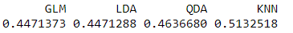
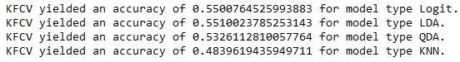
K-fold CV test error rates show similar results for 3 of the 4 methods
K nearest neighbors (KNN) performs worst with >50% test error rate
Linear discriminant analysis (LDA) performs best but still relatively low accuracy
R output shows test error rate = 0.45
Python output shows test accuracy rate = 0.55
R Output
Python Output
Notes:
All results relatively low accuracy ~50/50 (flip a coin). Might choose logistic regression model as it is more interpretable

Slide 39
LOOCV: Now we use our function to do a k-fold CV with k=the length of the data. (By definition LOOCV is N-fold CV. )
R Code
Python Code
n0 <- nrow(Weekly)
errRate2 <- matrix(0,4,n0)
rownames(errRate2) <- c("GLM", "LDA", "QDA", "KNN")
for(i in 1:n0){
train <- KFCVSplit(Weekly, n0, i)[[1]]
test <- KFCVSplit(Weekly, n0, i)[[2]]
…
}
apply(errRate2, 1, mean)
k = len(weekly)
guessAccuracy = [[0 for i in range(4)] for j in range(k)]
for i in range(0, k):
train, test = KFCVSplit(weekly, k, i))
…
guessAccuracyDF = pd.DataFrame(data=guessAccuracy, columns=["logit", "LDA", "QDA", "KNN"])
Notice instead of looping through 10 times, we loop through # rows
Notes:
Notice the code is almost identical to before

Slide 40
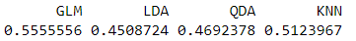
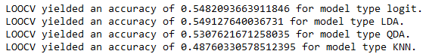
LOOCV test error rates also show similar results for 3 of the 4 methods
K nearest neighbors (KNN) performs worst with >50% test error rate
Linear discriminant analysis (LDA) performs best but still relatively low accuracy
R output shows test error rate = 0.45
Python output shows test accuracy rate = 0.55
R Output
Python Output
Notes:
All results relatively low accuracy ~50/50 (flip a coin). Might choose logistic regression model as it is more interpretable

Slide 41
Bootstrap: The most common application is estimating standard deviations; so, its use is mostly limited to methods that produce estimators.
R Code
Python Code
boot.fn <- function(data,index){
bootglm <- glm(Direction ~ Lag1 + Lag2 + Lag3 +
Lag4 + Lag5 + Volume,
data=data,subset=index,
family=binomial())
return(bootglm$coefficients)
}
boot(Weekly,boot.fn,1000)
k = 1000
for i in range(0, k):
sample = weekly.sample(n=100)
…
print(coeffTable.std())
For the python code, we do things a little differently…we use a for loop to sample from our original dataset and run our model multiple times (1,000 here), saving the results of each run in the process
For the R code, we write a function to run and output the coefficients of our model
We then apply R’s “boot” function to our own function’s output
Finally, we find the Std. dev of the different results

Slide 42
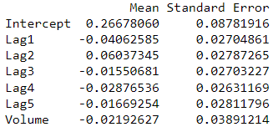
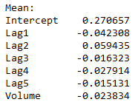
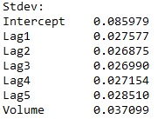
Bootstrap estimates of standard deviations
R Output
Python Output

Slide 43
Resampling Methods

Slide 44
Introduction to Machine Learning Course Roadmap
What is the goal of the data analysis?
Predict an output |  |  |  |  |  | Reveal patterns or relationships |  | Make decisions using an autonomous agent
Supervised Learning (Output in the data set) |  |  |  |  |  | Unsupervised Learning (No output in the data set) |  | Reinforcement Learning* (Supervised & unsupervised)
Continuous or discrete output? |  |  |  |  |  | What is the subgoal? |  | Does a model exist?
Continuous |  |  | Discrete |  |  | Identify groups | Reduce dimensions | Model Based | Model Free
Simple linear regression Multiple linear regression Subset selection Ridge regression & LASSO PCR & PLS | Polynomial regression Step functions Splines Local regression General additive models | Decision tree Random forest Neural network Gradient boosting tree | Logistic regression Linear discriminant analysis Quadratic discriminant analysis | Decision tree Random forest Neural network Gradient boosting tree | Support vector machines | Hierarchical clustering K-means clustering | Principal components analysis | Given the model Learn the model | Policy Optimization Q-Learning
*Advanced Topic: Bonus module if time

Slide 45
Now you should be able to:
Define resampling
Identify types of cross-validation
Describe the bootstrap process
Describe pros and cons of resampling methods
Implement basic cross-validation and bootstrap methods using Python

